Slide 1
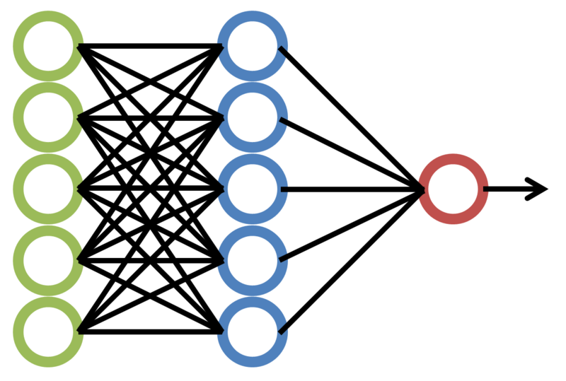
Session 1 – Stats & ML
1

Slide 2
Agenda
Normal Distribution.
Mean, Median, Mode, and Standard Deviation.
NUMPY and PANDAS Installation.
Regression techniques.
Classification techniques.
Metrics.
R^2 metrics
Accuracy
Confusion Matrix
Recall and Precision
2

Slide 3
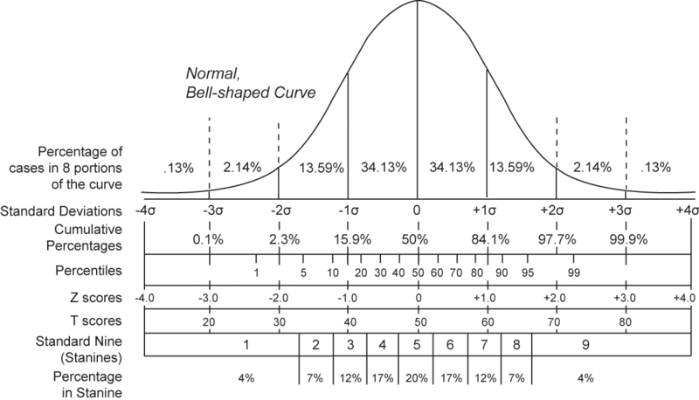
Normal Distribution
A normal distribution is an arrangement of a data set in which most values cluster in the middle of the range and the rest narrow down symmetrically towards extreme.
Properties:
1. Bell Shape curve.
2. The mean and median are equal.
3. 68% of the data falls within 1 standard deviation.
4. Symmetrical about the mean.
https://tg.m.wikipedia.org/wiki/%D0%90%D0%BA%D1%81:Normal_distribution_and_scales.gif
3

Slide 4
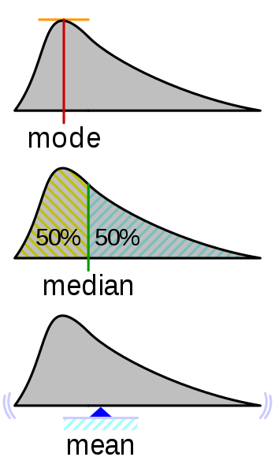
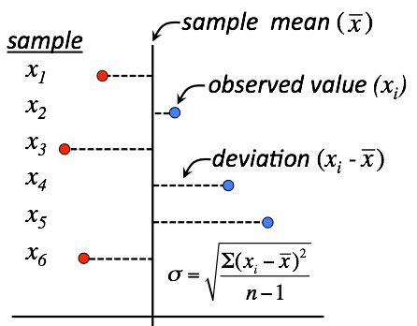
Normal Distribution – Mean, Median, Mode, Standard Deviation
Mean, median and mode are three widely used averages in Statistics.
Mean = Add all the values and divide it by the total number of values.
Median = The center or middle value in the given list of values.
Mode = The value that occurs the most often in the given list of values
Standard deviation = It is used to measure the spread of the data from mean value. A low SD means values are closer to the mean whereas a high SD means values are spread out from the mean value.
Standard deviation
https://commons.wikimedia.org/wiki/File:Visualisation_mode_median_mean.svg
https://commons.wikimedia.org/wiki/File:Visualization_of_standard_deviation.svg
4

Slide 5
Normal Distribution
For a perfectly symmetric normal distribution, if the mean is 10, how much percentage of values lie below 10?
The data is symmetric and normally distributed. The mean of the total number of vehicles crossing a particular junction per hour is 20 and the standard deviation is 2. What is the probability that at least 18 vehicles pass through that junction in an hour?
Find the mean, median, mode, and range for the following list of values: 1, 2, 4, 6
5

Slide 6
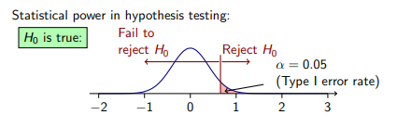
Normal Distribution – Hypothesis testing
Null hypothesis:
Given a set of values or observations, there is no significant difference or relationship between them.
It is denoted as H0 (H-zero)
This is the hypothesis we try to disprove.
Alternative hypothesis:
Given a set of values or observations, there is a significant difference or relationship between them.
It is denoted as H1 (H-one)
This is the hypothesis we try to prove.
Null hypothesis: “x is equal to y.” Alternative hypothesis “x is not equal to y.”
Null hypothesis: “x is at least y.” Alternative hypothesis “x is less than y.”
Null hypothesis: “x is at most y.” Alternative hypothesis “x is greater than y.”
6

Slide 7
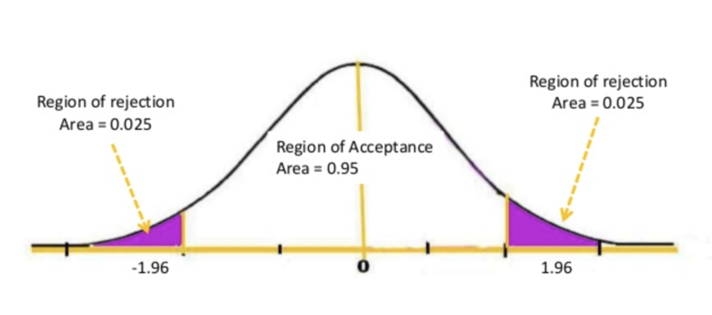
Normal Distribution – P value, alpha value, confidence interval
P value: The P value, or calculated probability, is the probability of finding the observed, results when the null hypothesis (H0) is true. It can be one sided or two sided.
Alpha: The term significance level (alpha) is used to refer to a pre-chosen probability.
If your P value is less than the chosen significance level then you reject the null hypothesis.
Confidence interval = 1 – Alpha
https://commons.wikimedia.org/wiki/File:Region_of_rejections_or_acceptance.png
7

Slide 8
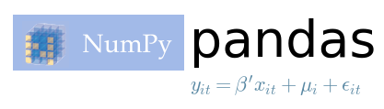
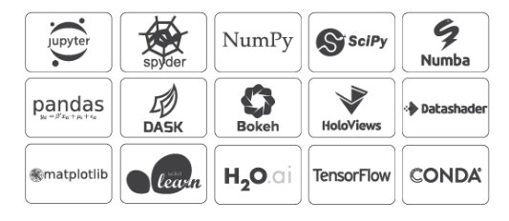
Python for data science – Numpy and Pandas
Installation of Numpy and Pandas:
pip install numpy
pip install pandas
Both Numpy and Pandas come by default if you can install Anaconda in your desktops. This is recommended for training purposes
Installation of Anaconda -https://www.anaconda.com/distribution/
import numpy as np
import pandas as pd
8

Slide 9
Python for data science – Numpy and Pandas
Numpy:
Numpy is the fundamental package for scientific computing with Python. It contains among other things:
a powerful N-dimensional array object
sophisticated (broadcasting) functions
useful linear algebra, Fourier transform, and random number capabilities
Pandas:
Pandas is an open source, BSD-licensed library providing high-performance, easy-to-use data structures and data analysis tools for the Python programming language.
URL: https://numpy.org/
URL: https://pandas.pydata.org/
9

Slide 10
Python for data science – Numpy and Pandas
Create a list of values 1,2,3 in python and append 4 to it. Hint: Use [] for python lists.
Create a dictionary with keys as a,b,c and values as 10,20,30. Hint: Use {} for python dictionaries.
Create two lists in python 1,2,3 and 4,5,6 and append the second to first. What do you see? Extend the first list by the second. What do you see?
Create an ndarray using numpy with values 1,2,3,4,5,6,7,8,9. Hint: Import numpy before attempting.
Reshape the above array into 3x3 matrix. Hint: Use shape function of array.
Create an ndarray using numpy with values 9,8,7,6,5,4,3,2,1. Reshape into 3x3.
Output dot product of both the arrays created in step 4 and step 5.
Create a Identity matrix of dimension 2x2.
Read the attached csv file using read_csv function of pandas into a variable. Hint: Import pandas before attempting
Print the type of the variable. Hint: Use type() function
Select the first 2 rows and 2 columns of the dataframe. Hint: Use iloc function of pandas.
Select the max and min value of column – disp. Hint: Use max() and min() function of pandas.
10

Slide 11
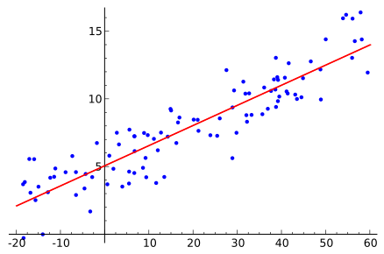
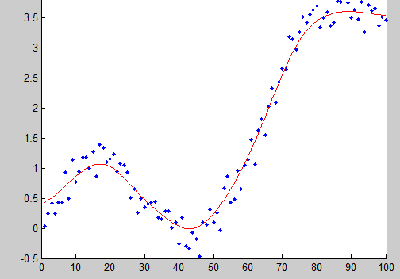
Regression techniques
Linear regression
Polynomial linear regression
https://upload.wikimedia.org/wikipedia/commons/8/8a/Gaussian_kernel_regression.png
https://commons.wikimedia.org/wiki/File:Linear_regression.svg
11

Slide 12
Simple linear regression
Simple linear regression:
Used to find statistical relationship between two variables (predictor and target variables)
The main idea behind linear regression is to find the best fit line. A best fit line will reduce the total predicted error to be as small as possible.
The error is the sum of squared difference between all the actual output and the predicted output. For each data point, find the difference between the actual and predicted values. Square the difference and add it to the error variable.
Equations: y = B0 + B1*x where B0 is the intercept or bias co-efficient and B1 is the co-efficient.
Assumes the relationship between input and output is linear and data is not noisy.
12

Slide 13
Polynomial regression
Polynomial regression:
Used to find statistical relationship between two variables as Nth degree polynomial.
Can be useful when the relationship is curvilinear.
In Polynomial regression, it is not necessary that the relationship between independent variables be independent.
Used in cases where model is quadratic in nature or of a higher degree.
It assumes there are no outliers in your data. Polynomial regression is sensitive to outliers and this can cause the model to over fit.
Equations: y = b0 + b1x + b2x^2 +....+ bnx^n
13

Slide 14
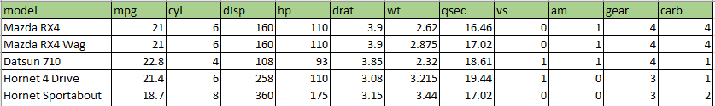
Regression demo
Linear regression:
Import the necessary libraries. Numpy, Pandas and Matplotlib.
Read the csv file into a dataframe.
Standardize the data, if necessary. Use StandardScaler here.
Split data into dependent and independent variable. Here mpg column is the dependent variable.
From scikit learn library import LinearRegression
Pass in the dependent and independent variable.
Predict the data.
Sample data:
14

Slide 15
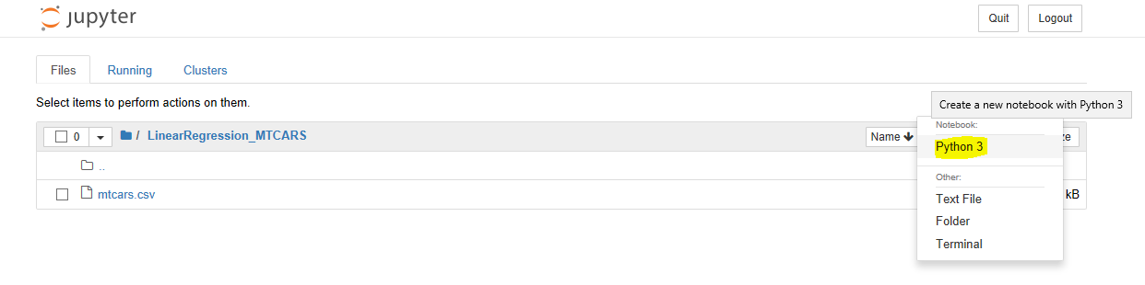
Regression demo - continued
Create a new python file in Jupyter. This will open a new python file in browser.
Upload the mtcars dataset into Jupyter.
15

Slide 16
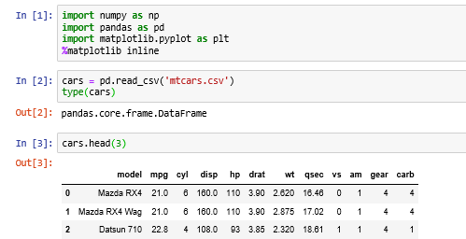
Regression demo - continued
Import the dataset into variable – cars using pandas.
16

Slide 17
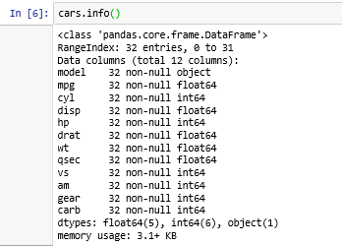
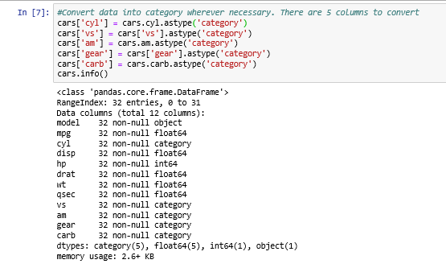
Regression demo - continued
Before converting categorical columns into category
After converting categorical columns into category
17

Slide 18
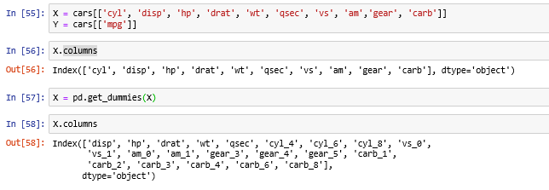
Regression demo - continued
Split the dependent and independent columns. As mentioned earlier, mpg is dependent, rest are not.
Use get_dummies to expand your categorical columns.
Check what get_dummies() does
18

Slide 19
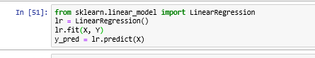
Regression demo - continued
At this point, the dependent and independent variables are ready to be passed to the algorithm.
Import the necessary algorithm.
Pass on the data to the fit method of LinearRegression.
Predict the output using predict method.
Check how to split dataset into test and training data? Hint: Use
from sklearn.model_selection import train_test_split
https://scikit-learn.org/stable/modules/generated/sklearn.model_selection.train_test_split.html
19

Slide 20
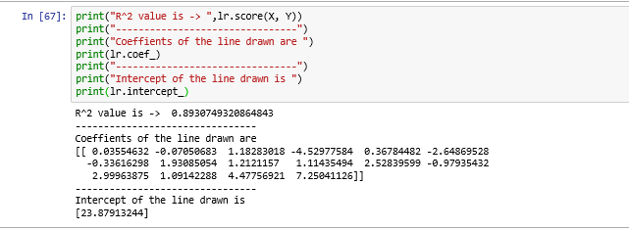
Regression demo - continued
Now, the model has predicted its output for the given input. Let us calculate the metrics and parameters of the equation.
R^2 metrics is calculated using the score() function.
Coefficients of the line can be obtained using coef_ attribute
Intercept can be obtained using intercept_ attribute.
20

Slide 21
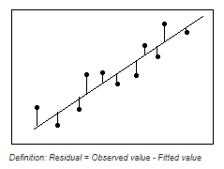
Regression - metrics
R^2 metric:
R^2 can be negative.
Best value of R^2 can be 1.
R^2 metric can be calculated as 1 – (u/v) where
u = ((y_true – y_pred)**2 ).sum()
v= ((y_true – y_true.mean())**2).sum()
R-squared is a statistical measure of how close the data are to the fitted regression line. It is also known as the coefficient of determination, or the coefficient of multiple determination for multiple regression.
The definition of R-squared is fairly straight-forward; it is the percentage of the response variable variation that is explained by a linear model.
https://blog.minitab.com/blog/adventures-in-statistics-2/regression-analysis-how-do-i-interpret-r-squared-and-assess-the-goodness-of-fit
21

Slide 22
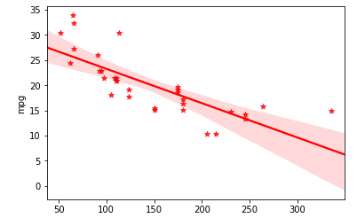
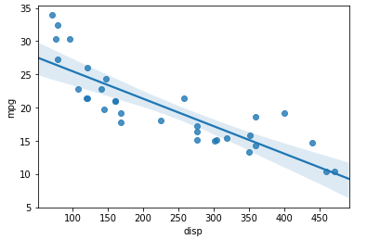
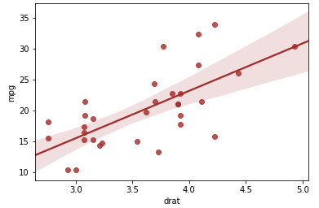
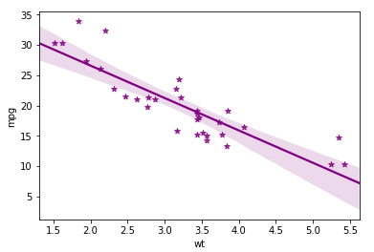
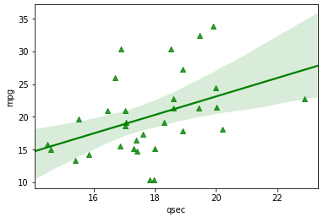
Regression plots from mtcars dataset
HP vs MPG
DISP vs MPG
DRAT vs MPG
WT vs MPG
QSEC vs MPG
22

Slide 23
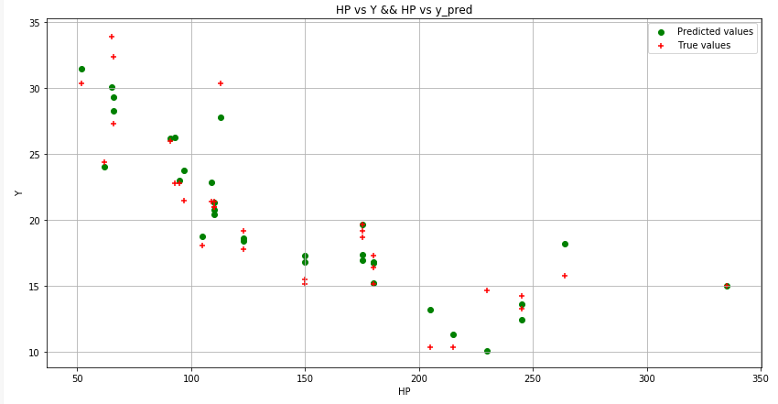
True values vs Predicted values
23

Slide 24
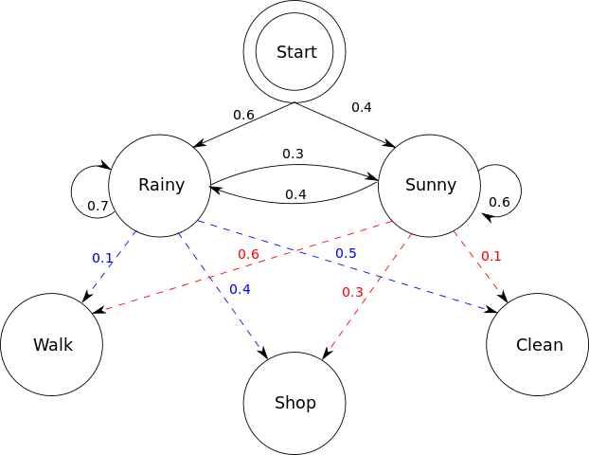
Classification techniques
Classification:
Used to categorize data into given number of classes.
The main motivation is to find under which class a given record falls under.
Binary classification - A task where the outcome can be either of the two classes given. Example is Win or Loss.
Multi class classification – A task where the outcome can belong to any one of the given classes. Example: A given image can be of a cat or a dog or a rabbit or a bird
Multi label classification – A task where the given record can belong to any one or more of the given labels. Example: news feed can be about a person, incident and mode of incident
https://en.wikipedia.org/wiki/Hidden_Markov_model#/media/File:HMMGraph.svg
24

Slide 25
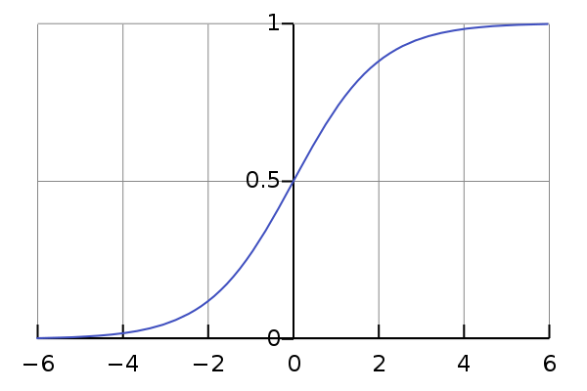
Logistic regression:
Logistic regression
Mainly used for binary classification.
Mainly called as logistic function or Sigmoid function.
Helps plot a S shaped curve where any given real value can be plotted between 0 and 1.
1/ (1 + e^-value)
If x is input, B0 is intercept, B1 is coefficient and y is the output then y = 1/(1+e^-(B0+B1x)
Logistic regression will model the probability of the default class.
Such predicted probabilities are then converted to 0 or 1, based on threshold values for a given problem.
25

Slide 26
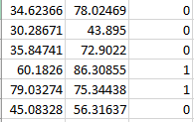
Logistic regression - Demo
Import the necessary libraries. Numpy, Pandas and Matplotlib.
Read the csv file into a dataframe.
Standardize the data, if necessary. Use StandardScaler here.
Split data into dependent and independent variable.
From scikit learn library import LogisticRegression.
Pass in the dependent and independent variable.
Predict the data.
Sample data
26

Slide 27
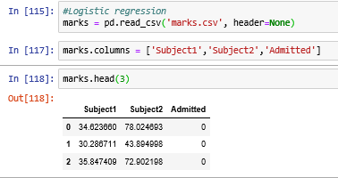
Logistic regression - Demo
Import the dataset into a variable using read_csv method.
Assign column names to the columns.
Print a sample of records and check whether import is successful.
27

Slide 28
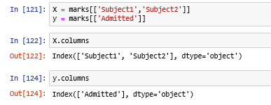
Logistic regression - Demo
Split the data into dependent and independent variables.
X – independent variables
Y – dependent variable
28

Slide 29
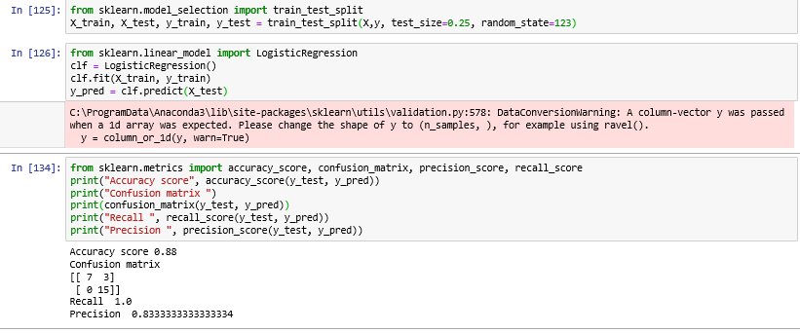
Logistic regression - Demo
Create an instance of LogisticRegression.
Fit the data into the instance created.
Predict the output for the new data that the model is yet to see.
29

Slide 30
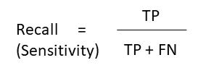
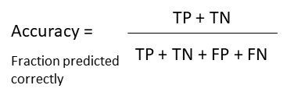
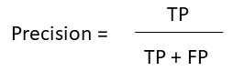
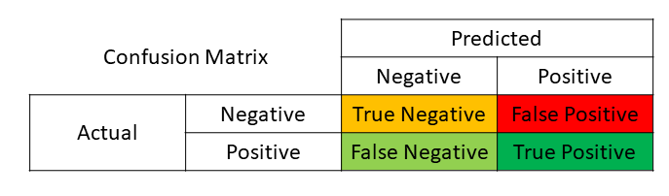
Logistic regression - metrics
False negative – outcome where the model incorrectly predicts the negative class.
False positive – outcome where the model incorrectly predicts the positive class.
Accuracy score – helps determine how accurate the classification is.
Confusion matrix – a table which summarizes the results of the algorithm.
Recall score – refers to the percentage of total relevant results correctly classified by the algorithm.
Precision score – refers to the percentage of your results which are relevant.
30

Slide 31
Thank you!
Post reads
https://www.simplilearn.com/10-algorithms-machine-learning-engineers-need-to-know-article
https://www.sas.com/en_ie/insights/articles/analytics/machine-learning-algorithms.html
https://www.edx.org/course/essential-math-for-machine-learning-python-edition-3
https://mml-book.github.io/
Thanks!
31

